Slide 1
Cell Cycle & Mitosis
Cell & Nucleus Dividing

Slide 2
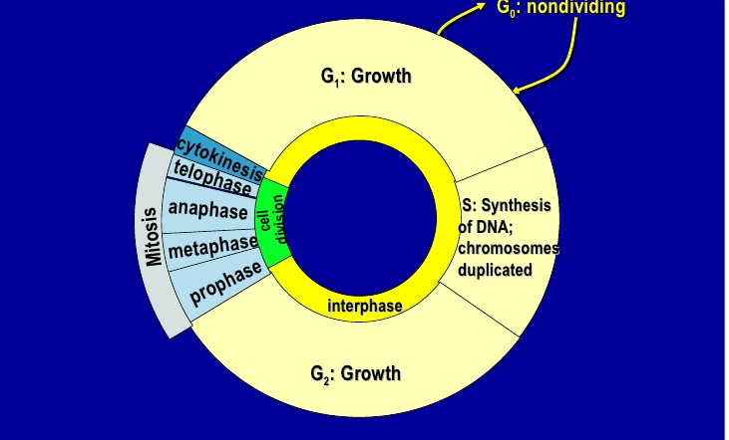
Cell Cycle

Slide 3
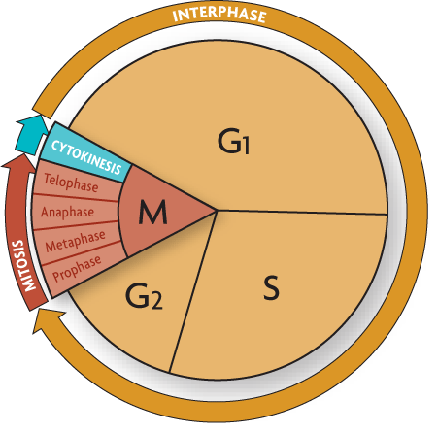

Slide 4
Interphase (G₁, S, G₂)
G₁ – Cell grows
S (synthesis phase) – DNA replicates
G₂ - Cell prepares for mitosis (nuclear division)

Slide 5
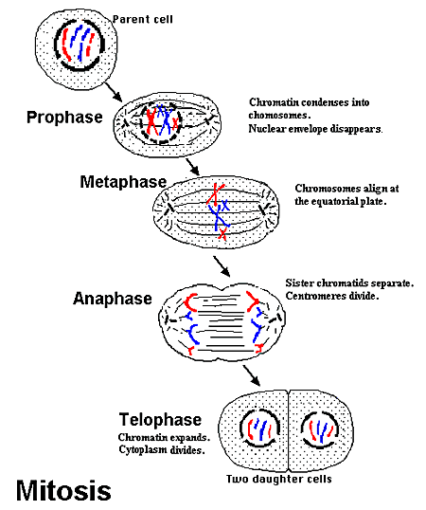
Mitosis (PMAT)

Slide 6
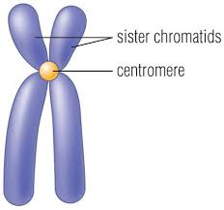
Prophase
Centrioles produce spindle fiber

Slide 7
Metaphase

Slide 8
Anaphase
Spindle fibers pull chromosome copies apart

Slide 9
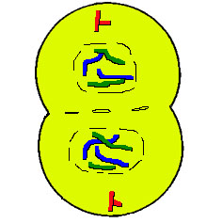
Telophase (end of mitosis) & Cytoskinesis
TelophaseThe chromosomes decondense The nuclear envelope forms Cytokinesis reaches completion, creating two daughter cells

Slide 10
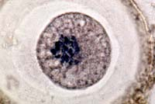
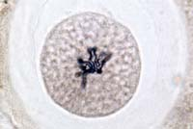
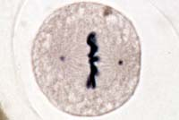
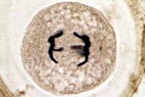
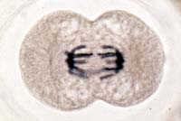
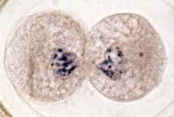
Animal Mitosis -- Review
Interphase | Prophase
Metaphase | Anaphase
Telophase | Interphase

Slide 11
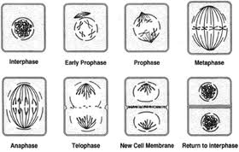
Plants
Cell does not split using cleaving, instead, a cell plate divides both sides

Slide 12
Why Would Cell Need to Divide?
Growth
Repair
Replacement
https://www.youtube.com/watch?v=JcZQkmooyPk

